Slide 1
Object Model

Slide 2
UML Diagram
UML stands for Unified Modeling Language.
UML diagrams are visual representations of the design, architecture, and implementation of software systems.
Package diagrams
State diagrams
Communication diagrams
Composite structure diagrams
Interaction overview diagrams
Timing diagrams
Activity diagrams

Slide 3
UML Class Diagram
The class diagram depicts a static view of an application. It represents the types of objects residing in the system and the relationships between them. A class consists of its objects, and also it may inherit from other classes.
it is a collection of classes, interfaces, associations, collaborations, and constraints
The main purpose of class diagrams is to build a static view of an application. It is the only diagram that is widely used for construction, and it can be mapped with object-oriented languages

Slide 4
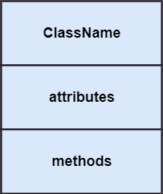
Class:Object

Slide 5


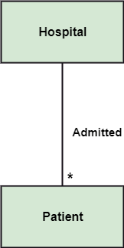
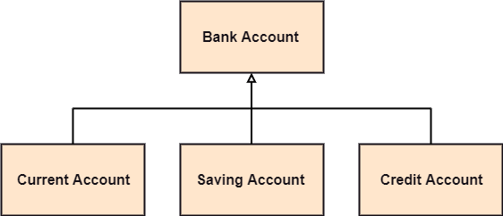
Relationships
Dependency Association
Generalization Multiplicity

Slide 6


Aggregation: An aggregation is a subset of association, which represents has a relationship. It is more specific then association. It defines a part-whole or part-of relationship.
Composition: The composition is a subset of aggregation. It portrays the dependency between the parent and its child, which means if one part is deleted, then the other part also gets discarded. It represents a whole-part relationship.
A contact book consists of multiple contacts, and if you delete the contact book, all the contacts will be lost.

Slide 7
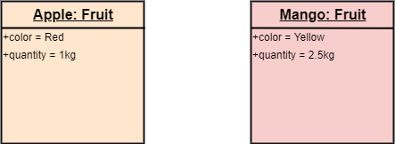
Representation of Object

Slide 8
Class vs. Object diagram
Serial No. | Class Diagram | Object Diagram
1. | It depicts the static view of a system. | It portrays the real-time behavior of a system.
2. | Dynamic changes are not included in the class diagram. | Dynamic changes are captured in the object diagram.
3. | The data values and attributes of an instance are not involved here. | It incorporates data values and attributes of an entity.
4. | The object behavior is manipulated in the class diagram. | Objects are the instances of a class.

Slide 9
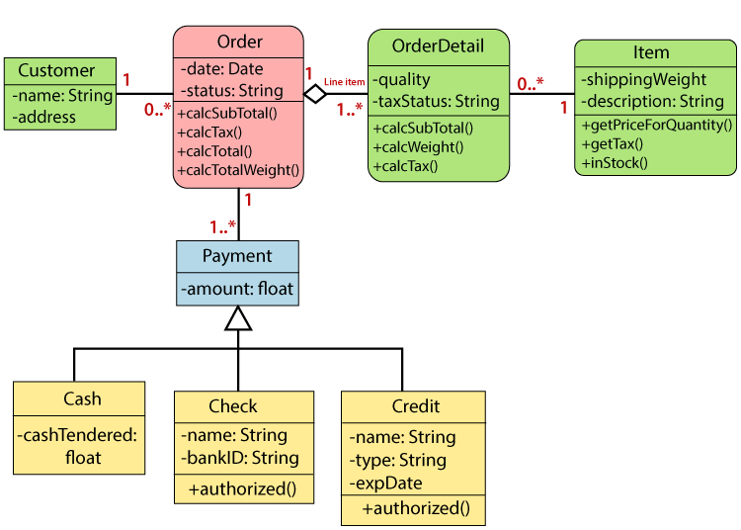

Slide 10
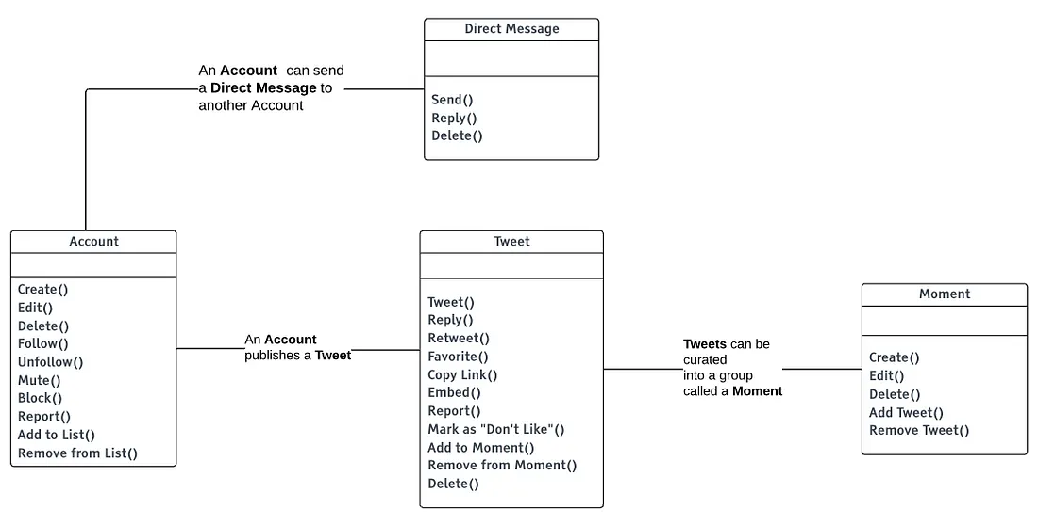
Narrative Object Model for Twitter showing the relationship between objects and each object’s actions.

Slide 11
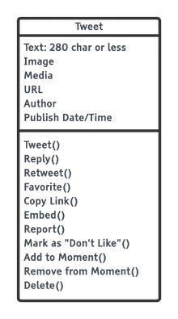
Identifying Attributes

Slide 12
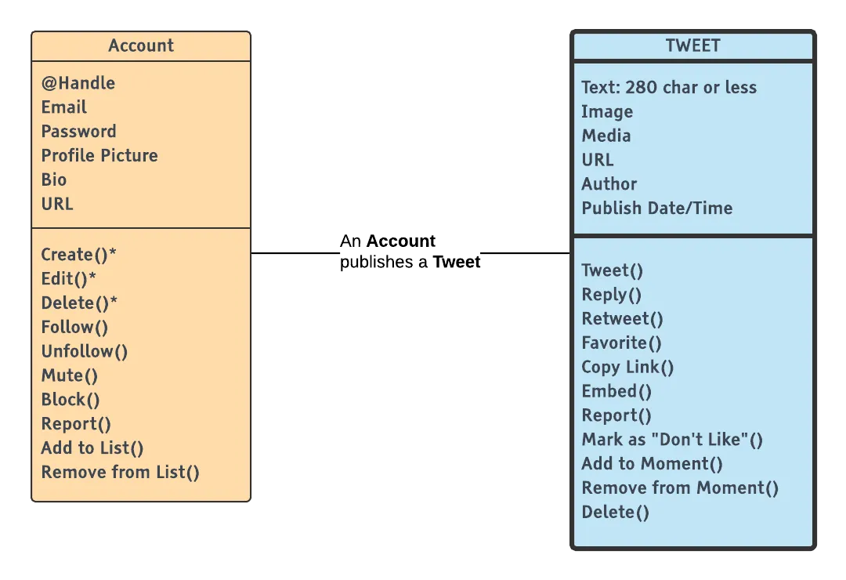
Association Relationship

Slide 13
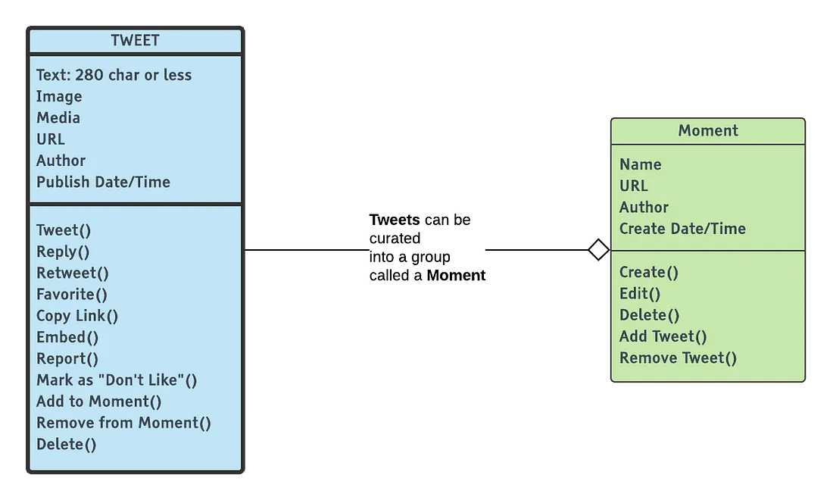
Aggregation Relationship An aggregation relationship, indicated by an unfilled diamond.

Slide 14
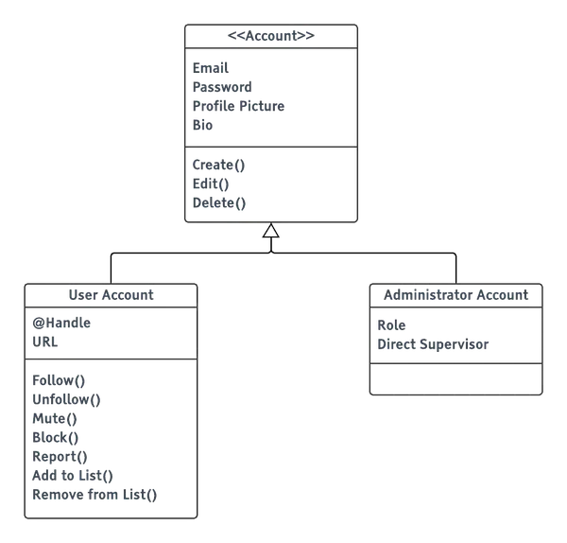
Inheritance Relationship

Slide 15
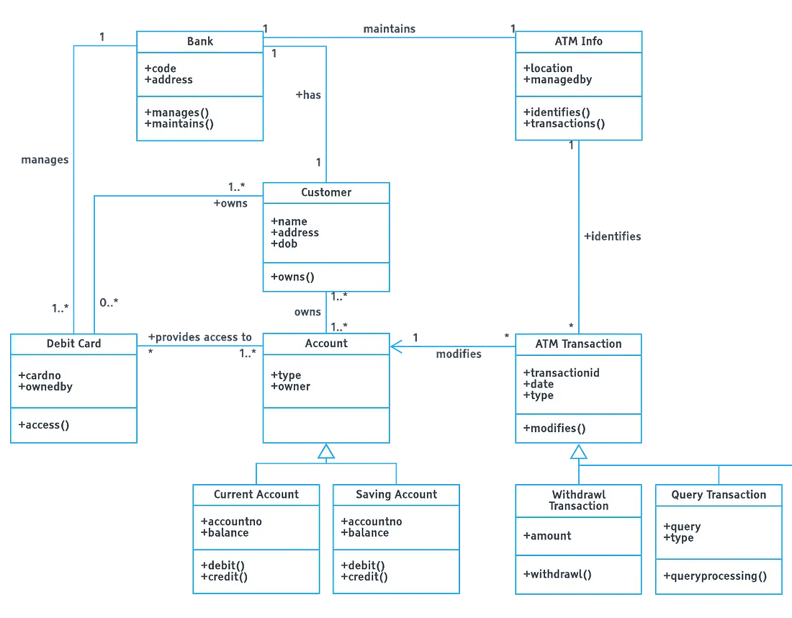

Slide 16
